Slide 1

AZERBAIJAN STATE OIL AND INDUSTRY UNIVERSITY
FACULTY: ITIF
GROUP:604.20E
TEACHER: SEVINJ KARIMOVA
STUDENT: GUNEL HUMBATOVA
SUBJECT: FUNDAMENTALS OF PROGRAMMING - 2

Slide 2
“Abstract Classes and Pure Virtual Functions (C++)”

Slide 3
Plan: 1. Virtual function and Pure virtual function in C++ 2.Virtual function example 3.Abstract class

Slide 4


Virtual function and Pure virtual function in C++
Virtual Function in C++
Pure Virtual Functions in C++
A virtual function a member function which is declared within a base class and is re-defined(Overriden) by a derived class. When you refer to a derived class object using a pointer or a reference to the base class, you can call a virtual function for that object and execute the derived class’s version of the function.
A pure virtual function (or abstract function) in C++ is a virtual function for which we don’t have an implementation, we only declare it. A pure virtual function is declared by assigning 0 in the declaration.

Slide 5

An abstract class is a class in C++ which have at least one pure virtual function.

Slide 6
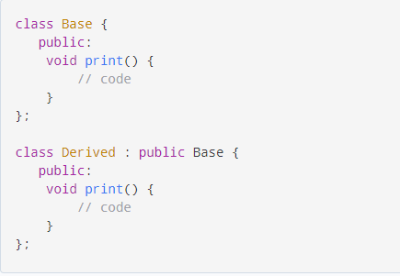
EXERCISE
Basically, a virtual function is used in the base class in order to ensure that the function is overridden. This especially applies to cases where a pointer of base class points to an object of a derived class.

Slide 7
Basically, a virtual function is used in the base class in order to ensure that the function is overridden. This especially applies to cases where a pointer of base class points to an object of a derived class.

Slide 8
ABSTRACT CLASS
Abstract class can have normal functions and variables along with a pure virtual function.
Abstract class cannot be instantiated, but pointers and references of Abstract class type can be created.
Abstract classes are mainly used for Upcasting, so that its derived classes can use its interface.
We can’t create object of abstract class as we reserve a slot for a pure virtual function in Vtable, but we don’t put any address, so Vtable will remain incomplete.

Slide 9
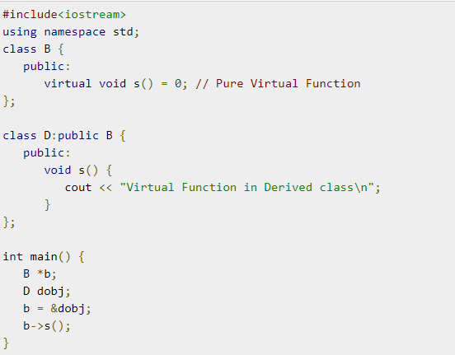
EXAMPLE CODE

Slide 10



Pure virtual functions in abstract classes can be defined, or have an implementation. You can only call such functions by using the fully qualified syntax:
abstract-class-name::function-name()
Defined pure virtual functions are helpful when you design class hierarchies whose base classes include pure virtual destructors. That's because base class destructors are always called during object destruction.

Slide 11

In general an abstract class is used to define an implementation and is intended to be inherited from by concrete classes. It's a way of forcing a contract between the class designer and the users of that class.

Slide 12
If we wish to create a concrete class (a class that can be instantiated) from an abstract class we must declare and define a matching member function for each abstract member function of the base class. Otherwise, if any member function of the base class is left undefined, we will create a new abstract class (this could be useful sometimes).

Slide 13
Abstract classes can't be used for:
01
03
02
04
Variables or member data
Argument types
Function return types
Types of explicit conversions

Slide 14

The purpose of an abstract class is to define a common protocol for a set of concrete subclasses. This is useful when defining objects that share code, abstract ideas, etc.
Abstract classes have no instances. An abstract class must have at least one deferred method (or function). To accomplish this in C++, a pure virtual member function is declared but not defined in the abstract class.

Slide 15
https://www.geeksforgeeks.org/pure-virtual-functions-and-abstract-classes/
https://en.wikibooks.org/wiki/C%2B%2B_Programming/Classes/Abstract_Classes
https://docs.microsoft.com/en-us/cpp/cpp/abstract-classes-cpp?view=msvc-160
RECOURCES
https://wwwpure-virtual-functions-and-abstract-classes-in-cplusplus.tutorialspoint.com/
https://www.tutorialspoint.com/pure-virtual-functions-and-abstract-classes-in-cplusplus
https://stackoverflow.com/questions/14189438/why-do-we-need-abstract-classes-in-c

Slide 16
THANKS!

